Slide 1
PARALLEL ALGORITHMS FOR ARRAY PROCESSORS
Parallel processing algorithms have been developed by many computer scientists for SIMD computers.
Perform parallel computations on vector or matrix types of data.
Important SIMD algorithms can be used to perform matrix multiplication, fast Fourier transform (FFT), matrix transposition, summation of vector elements, matrix inversion, parallel sorting, linear recurrence, boolean matrix operations, and to solve partial differential equations.

Slide 2
SIMD Matrix Multiplication
The differences between SISD and SIMD matrix algorithms are pointed out in their program structures and speed performances.
In general, the inner loop of a multilevel SISD program can be replaced by one or more SIMD vector instructions.
Let A = [a_{ik}] and B = [b_{kj} ]be n x n matrices. The multiplication of A and B generates a product matrix
C = A x B = [C_{ij}] of dimension n x n.

Slide 3

The elements of the product matrix C is related to the elements of A and B by:

Slide 4
There are n³ multiplications carried out with 3 levels of DO loops
Time complexity is proportional to n³

Slide 5
O(n³) algorithm for SISD matrix multiplication
For i = 1 to n Do
  For j = 1 to n Do
Cij = 0 (initialization)
For k = 1 to n Do
    c_{ij}=c_{ij} + a_{ik} . b_{kj} (scalar additive multiply)
  End of k loop
    End of j loop
End of i loop

Slide 6
O(n²) algorithm for SIMD matrix multiplication
For i = I to n Do
Par for k = I to n Do
C_{ik} = 0 (vector load)
For j = I to n Do
Par for k = 1 to n Do
C_{ik} = C_{ik} + a_{ij} . b_{jk} (vector multiply)
End of j loop
End of i loop

Slide 7
We need to implement matrix multiplication on SIMD computer with n PE’s
The algorithm constructs depends on memory allocations of A, B, C matrices in the PEM’s
Suppose we store each row vector of the matrix across the PEMs as shown in Fig 1.
Column vectors are then stored within the same PEM
This memory allocation scheme allows parallel access of all the elements in each row vector of the matrices
Based on this data distribution, we obtain the parallel algorithm for SIMD

Slide 8
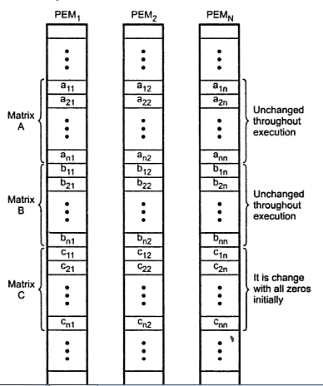
Memory allocation for SIMD matrix multiplication(Fig 1)

Slide 9
The 2 parallel DO’s corresponds to
Vector load for initialization & Vector multiply for the inner loop of additive multiplications
Time complexity has been reduced to O(n² )
Therefore,SIMD algorithm is n times faster than the SISD algorithm.
Vector load is performed to initialize row vectors of matrix C one row at a time.
In Vector multiply ,the same multiplier a_{ij} is broadcast from CU’s to all PE’s to multiply all n elements (b_{ik} for k = 1,2…n ) of the ith row vector of B.
In total , _{n}² vector multiply operations are performed
The successive memory contents in the execution of the SIMD matrix multiplication program are illustrated in Fig 2.

Slide 10
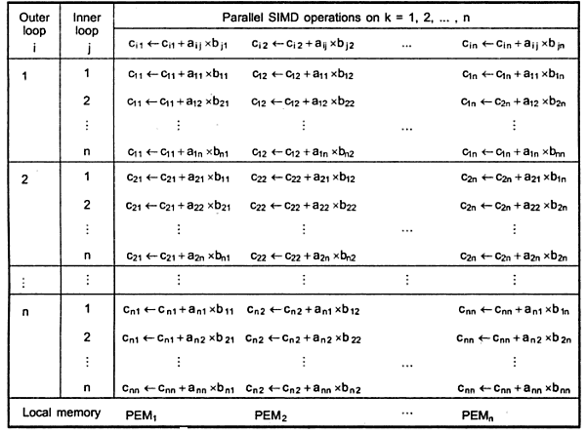

Successive contents of the C array in memory(Fig 2)

